Slide 1
Level 6 Group 2
Elliot Chester, George Heath-Collins, Thomas McCarthy and Thomas McLaren

Slide 2

Gaia
Designed for mobile and tablet
Single Player with Network Connectivity
Pet simulation game
Easy fun with focus on relaxation and nurturing behaviour
Designed for children between 7 and 14

Slide 3

Psychographic
Sally
Aged 14
Female
Grade 2 in Clarinet
She lives with her Mum and two siblings

Slide 4
Gaia
Here’s the current version: https://youtu.be/aGFcwuwYxfY

Slide 5

What does the player do?
Hatch Pets
Get Seeds
Upgrade
Breed Pets
Feed Pets
Plant Trees
Level up Pets
Grow Fruit

Slide 6
Criticism
A visual feedback for when the pet is eating Fruit + showing which stat increased
Pinching to zoom from pet stat window
Customizing the Giant and pets
Monetization

Slide 7
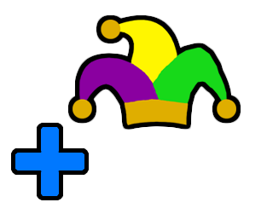
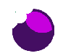
Addressing Criticism

Slide 8
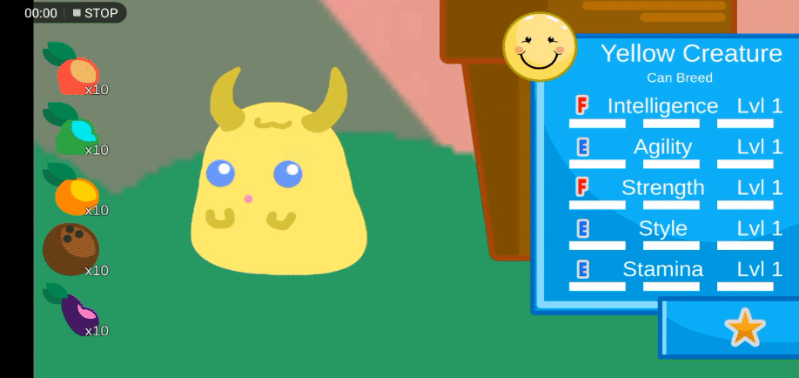
Addressing Criticism

Slide 9
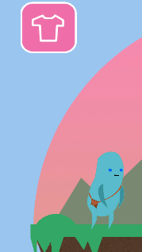
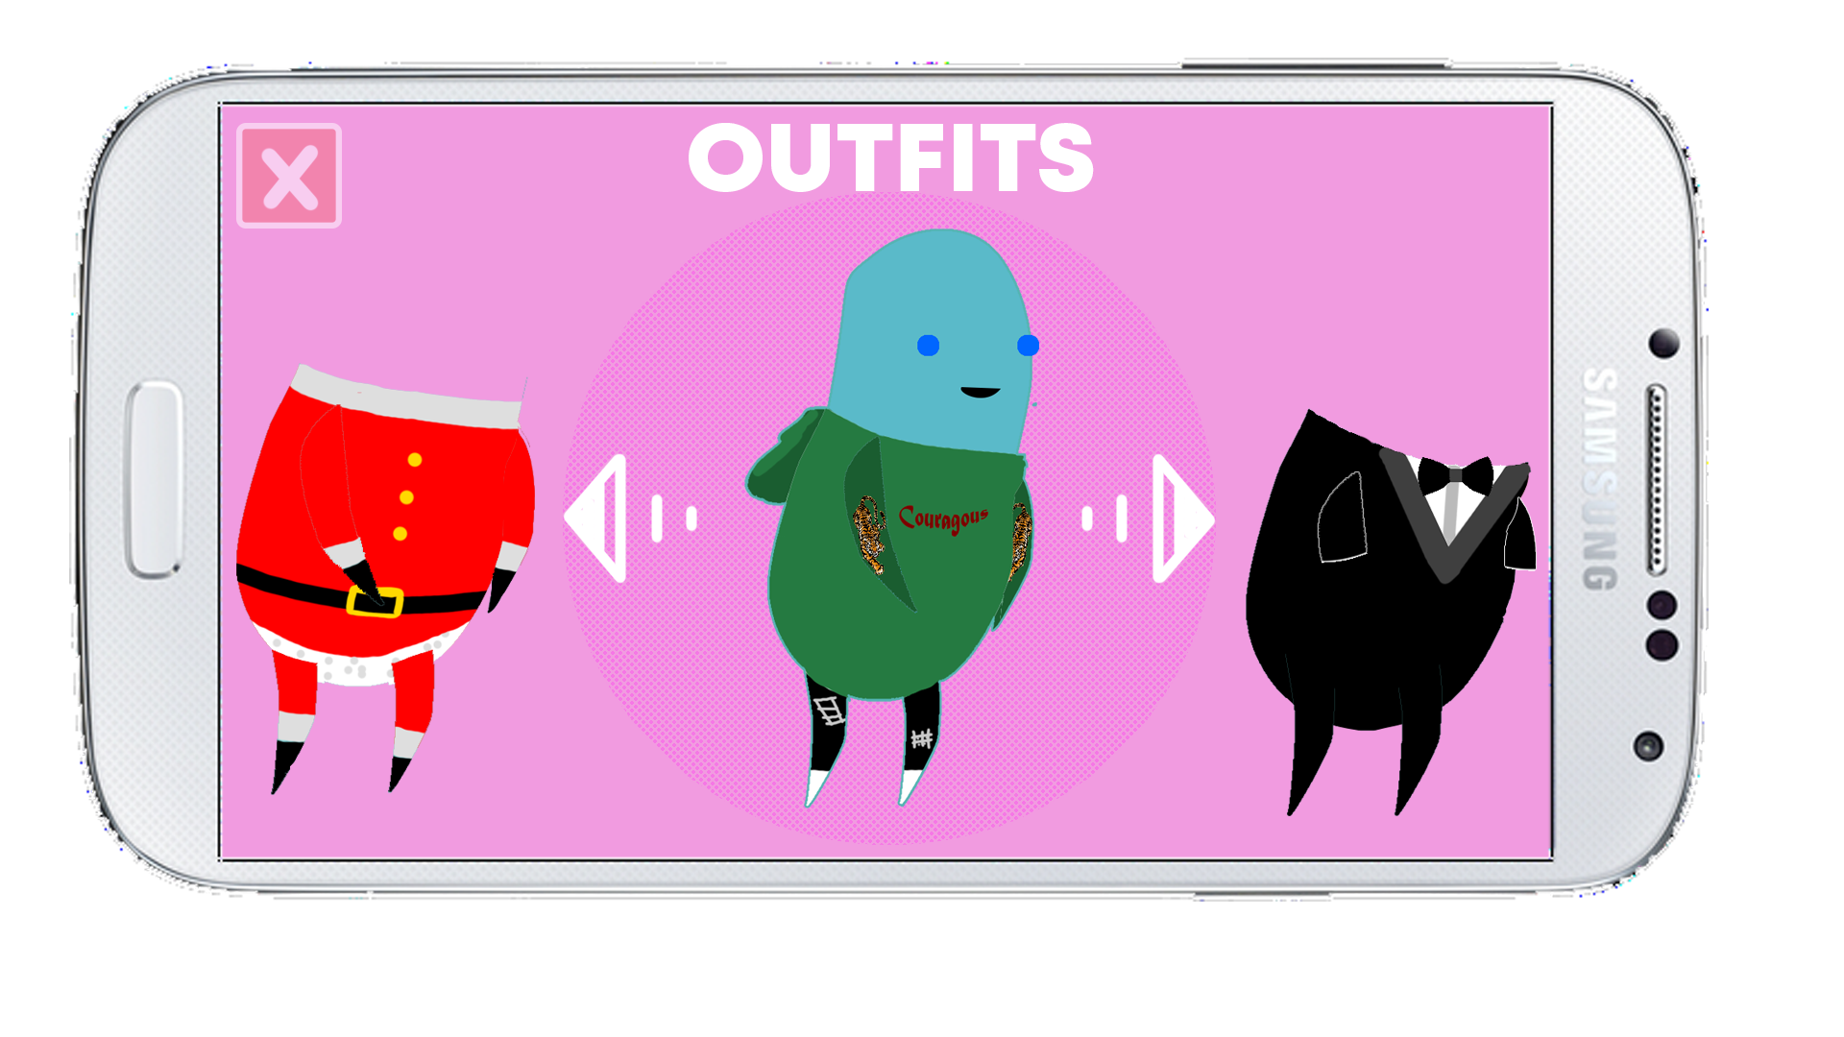
Addressing Criticism

Slide 10
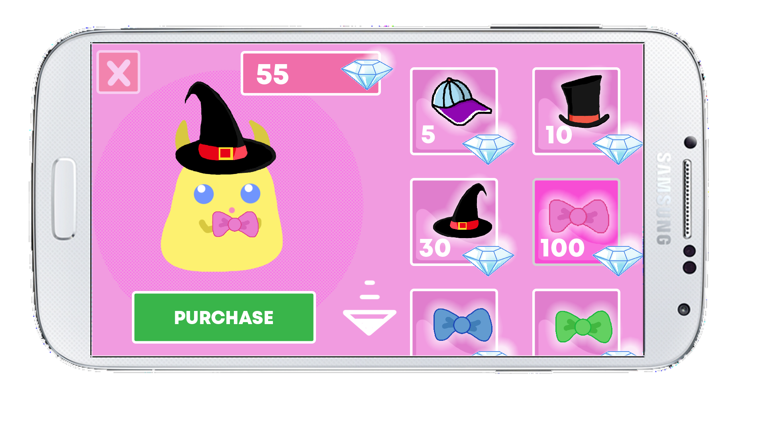
Addressing Criticism

Slide 11
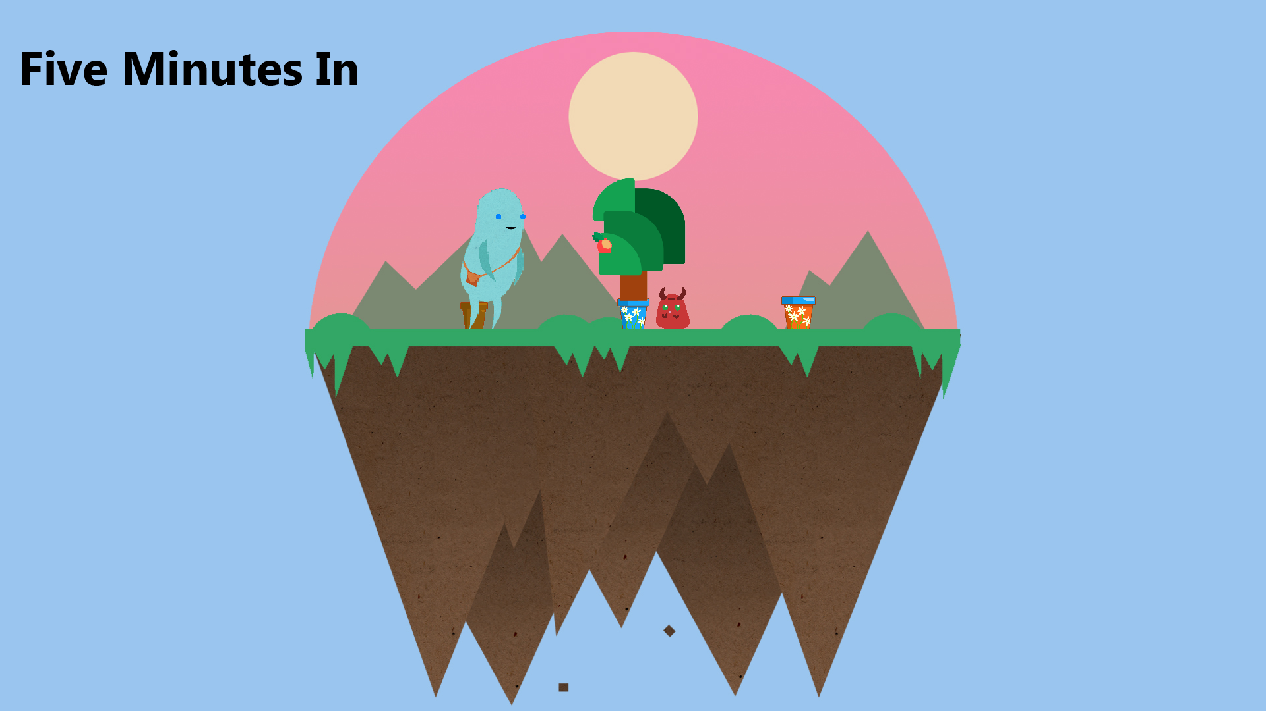
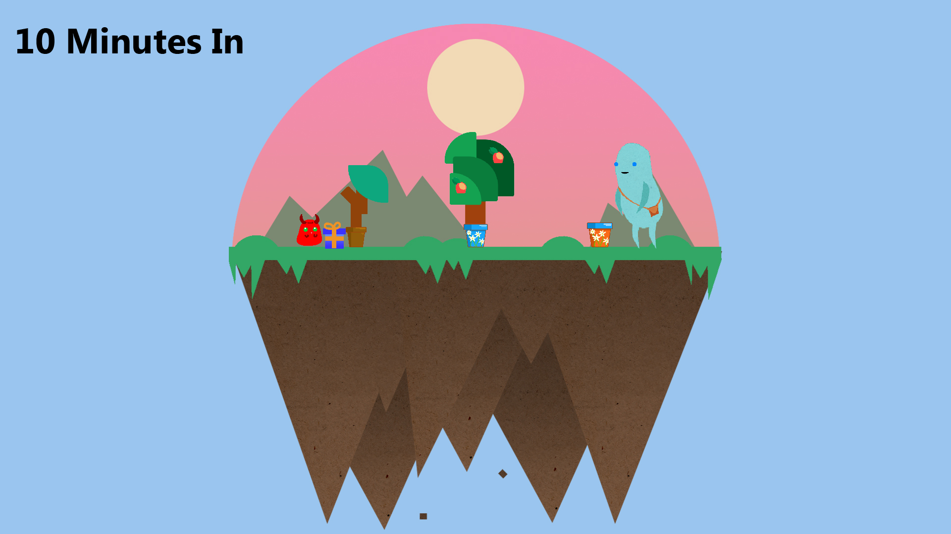
The Game Over Time

Slide 12
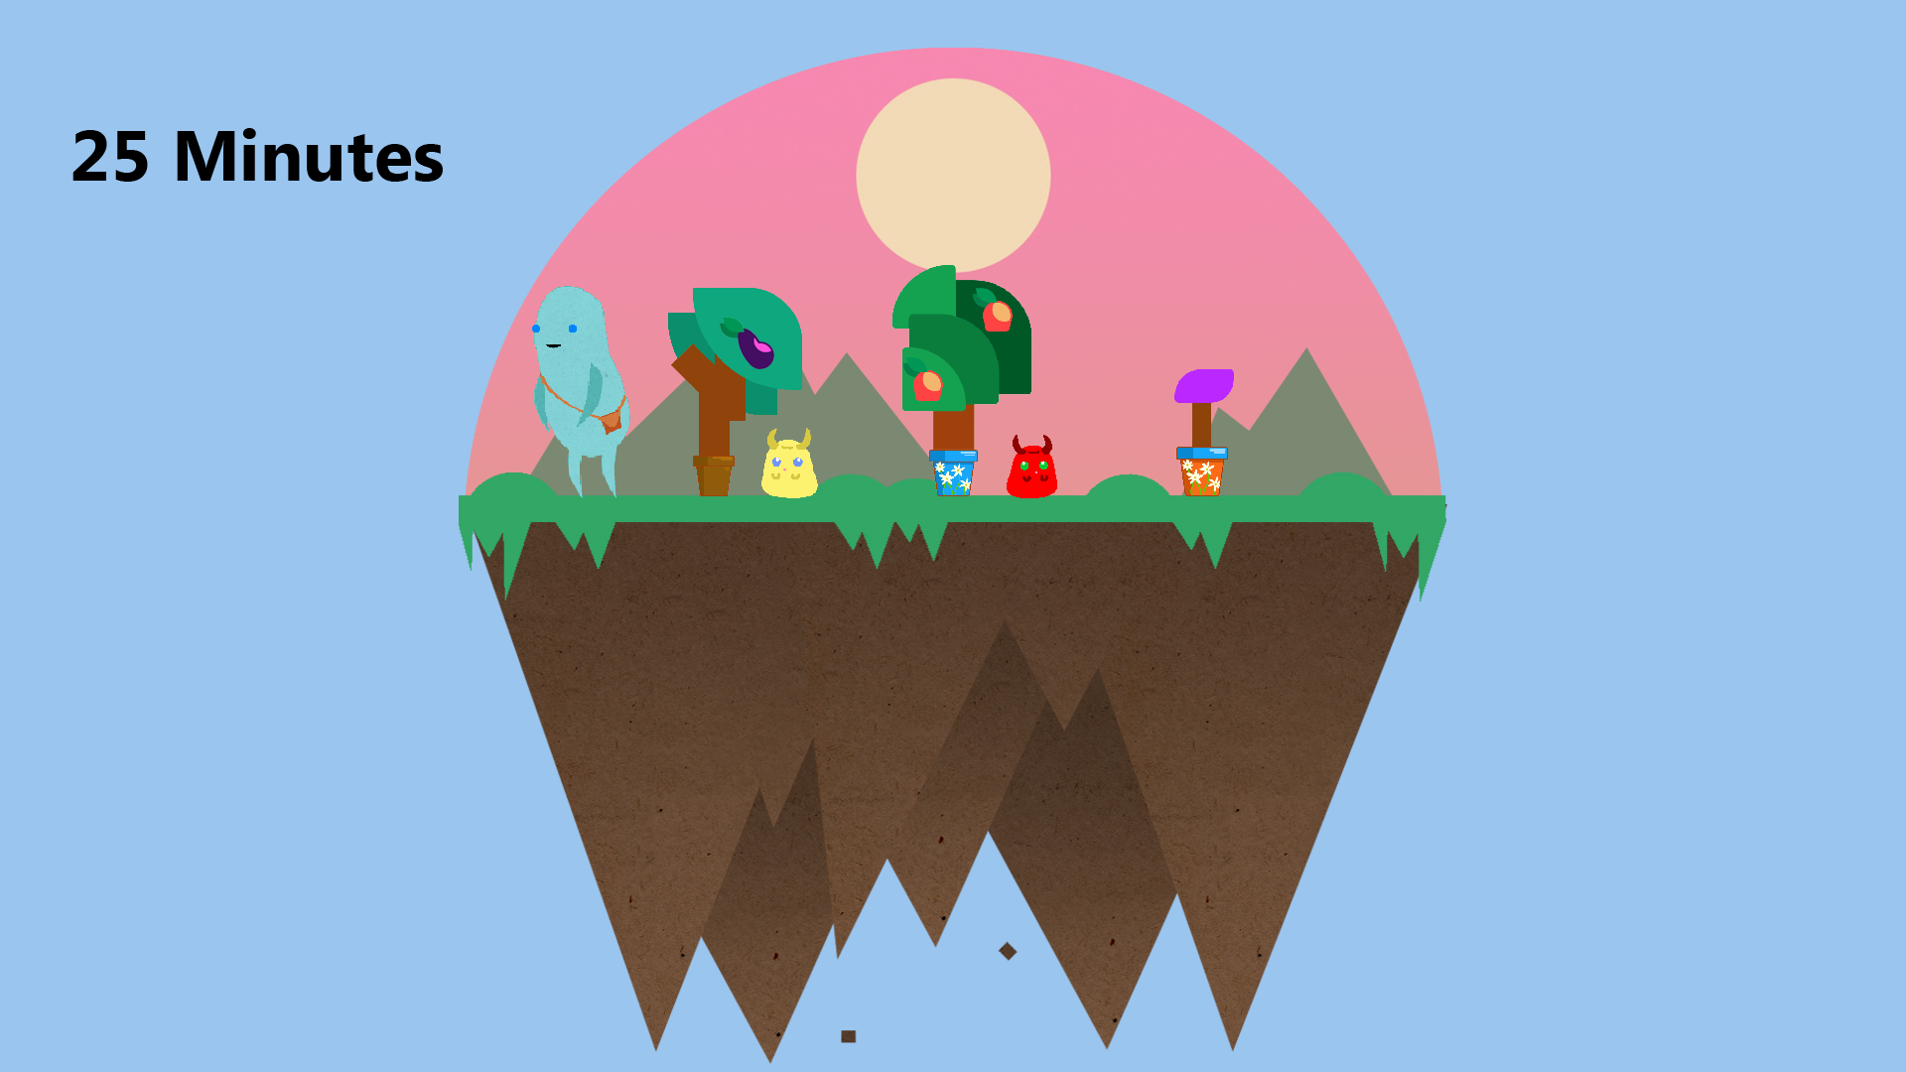
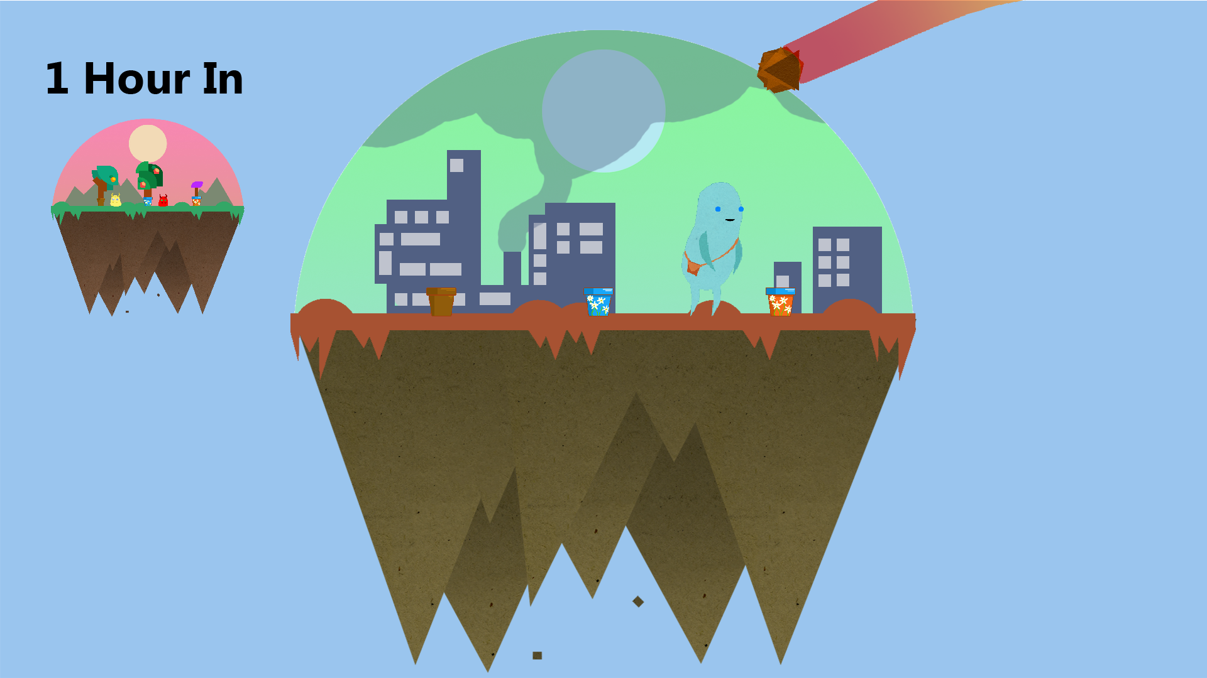
The Game Over Time

Slide 13
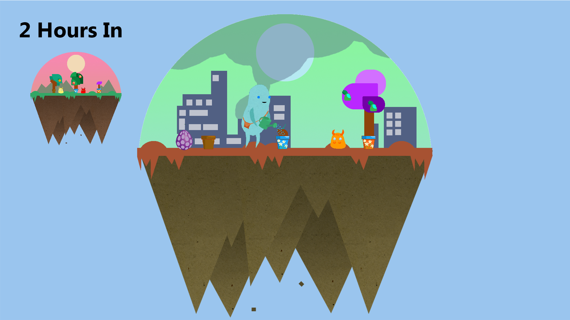
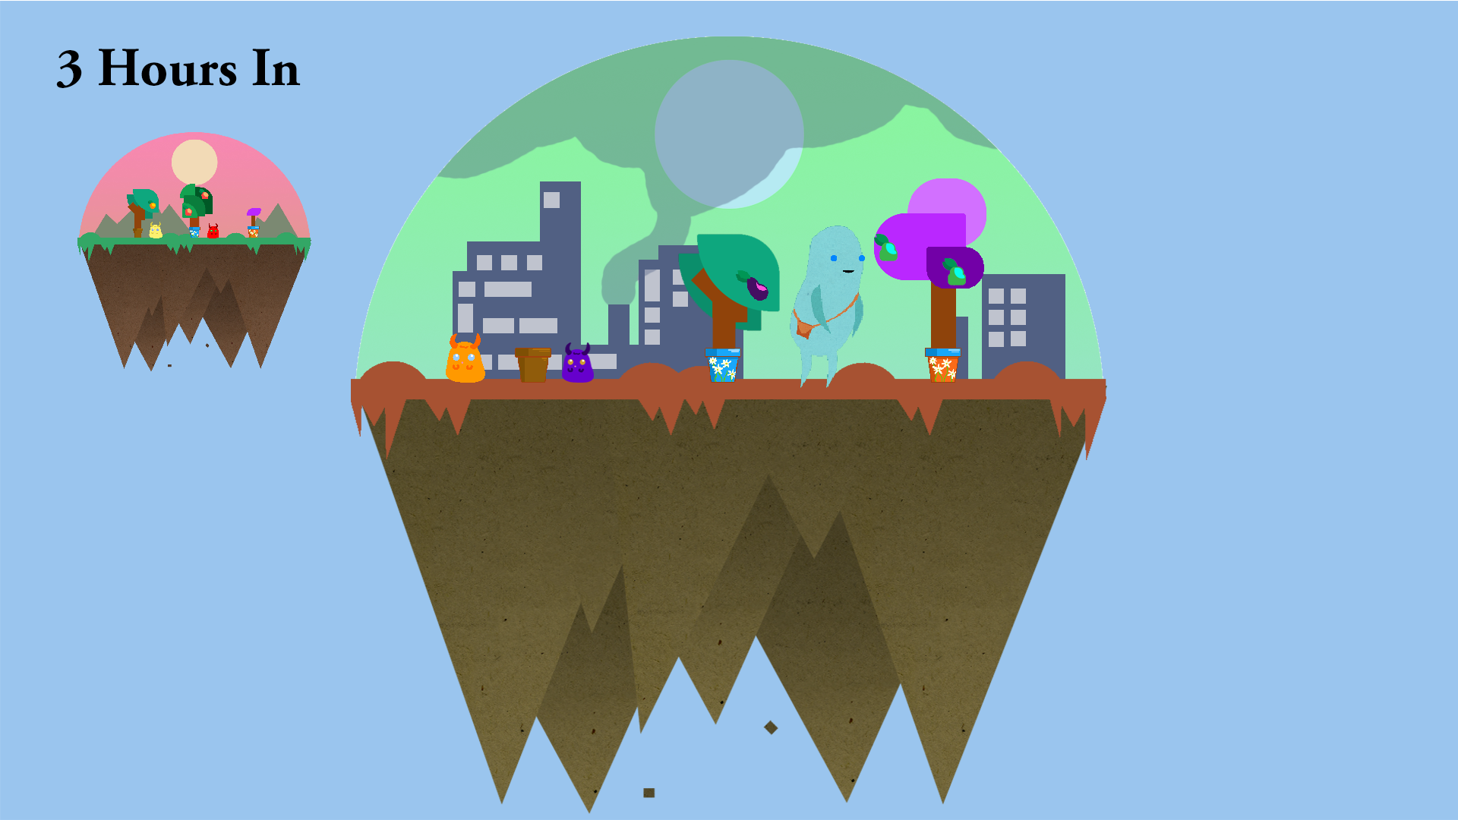
The Game Over Time

Slide 14
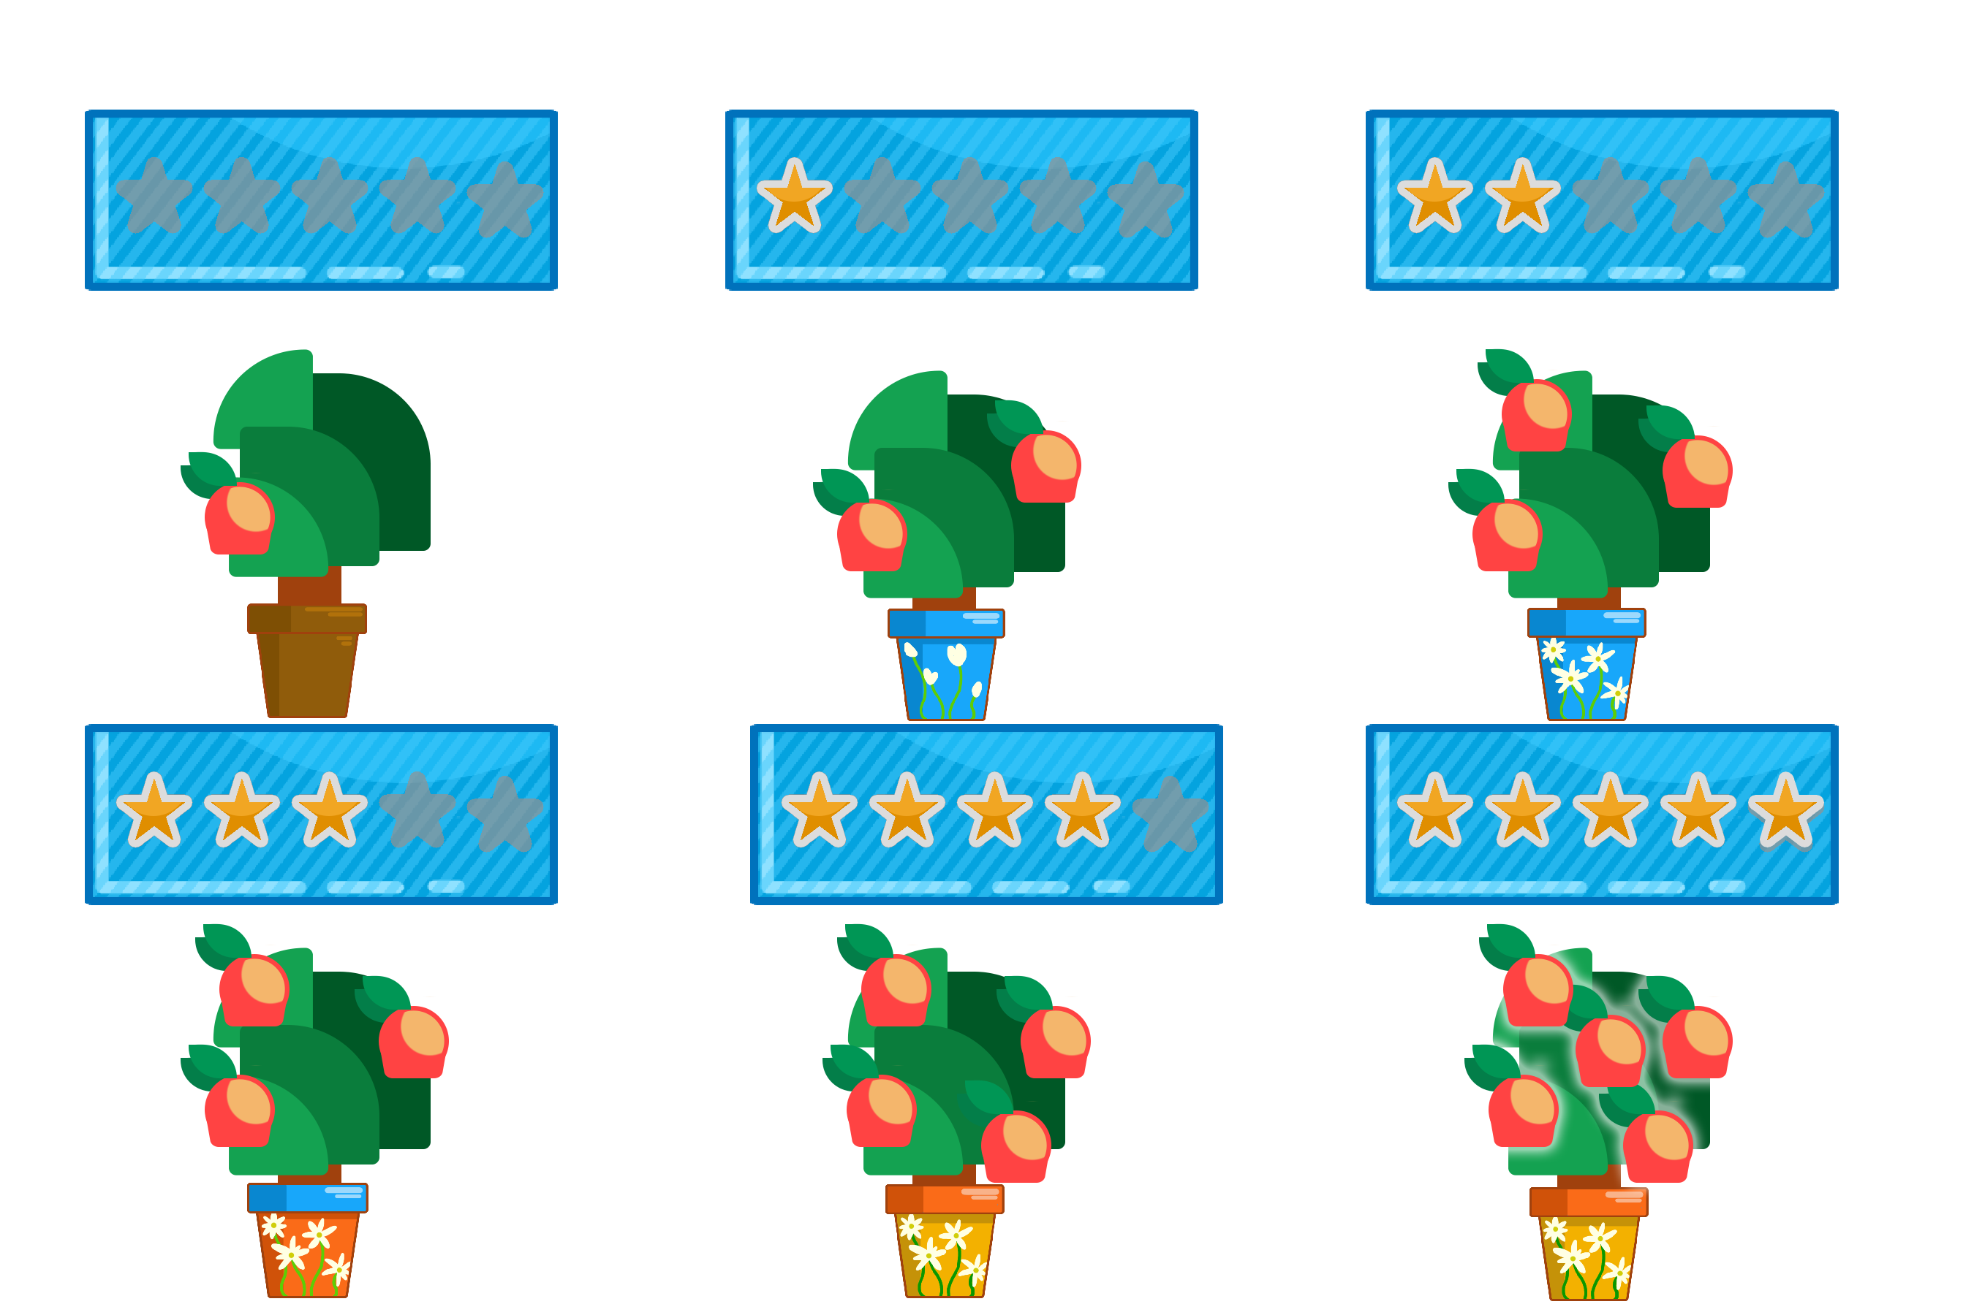
Upgrading Trees
Players can use seeds to plant or upgrade trees
Higher levels give more fruit
If Players want to replace a tree with another, it resets the level

Slide 15
Meaningful Decisions
Each Fruit affects one STAT massively and another minorly
There 3 Tree Spaces
Players can rapidly increase 3 STATs at a time
If each Tree is different, all STATs can be raised

Slide 16
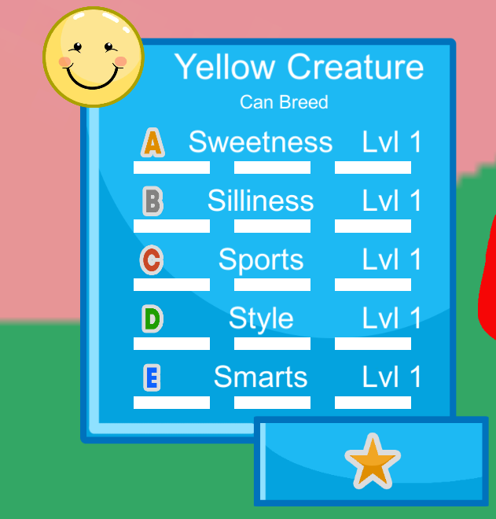
STATs and Affinity
Pets have 5 upgradeable STATs
Each STAT has an ‘Affinity’
Each STAT has a Level
Each STAT has an Actual Value

Slide 17
Caring for your pet
Each pet has a mood meter
Keeping pets happy will keep them engaging with you
Neglecting your pet will decrease it’s mood
If your pet is sad, it will avoid interaction

Slide 18
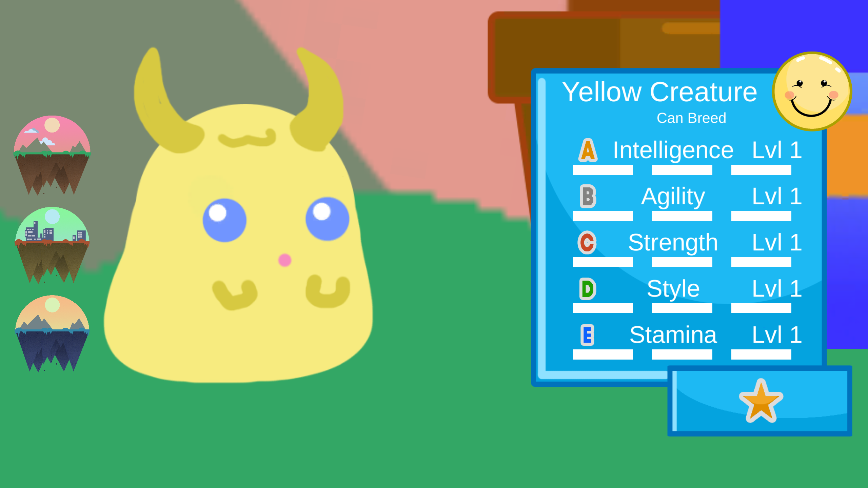
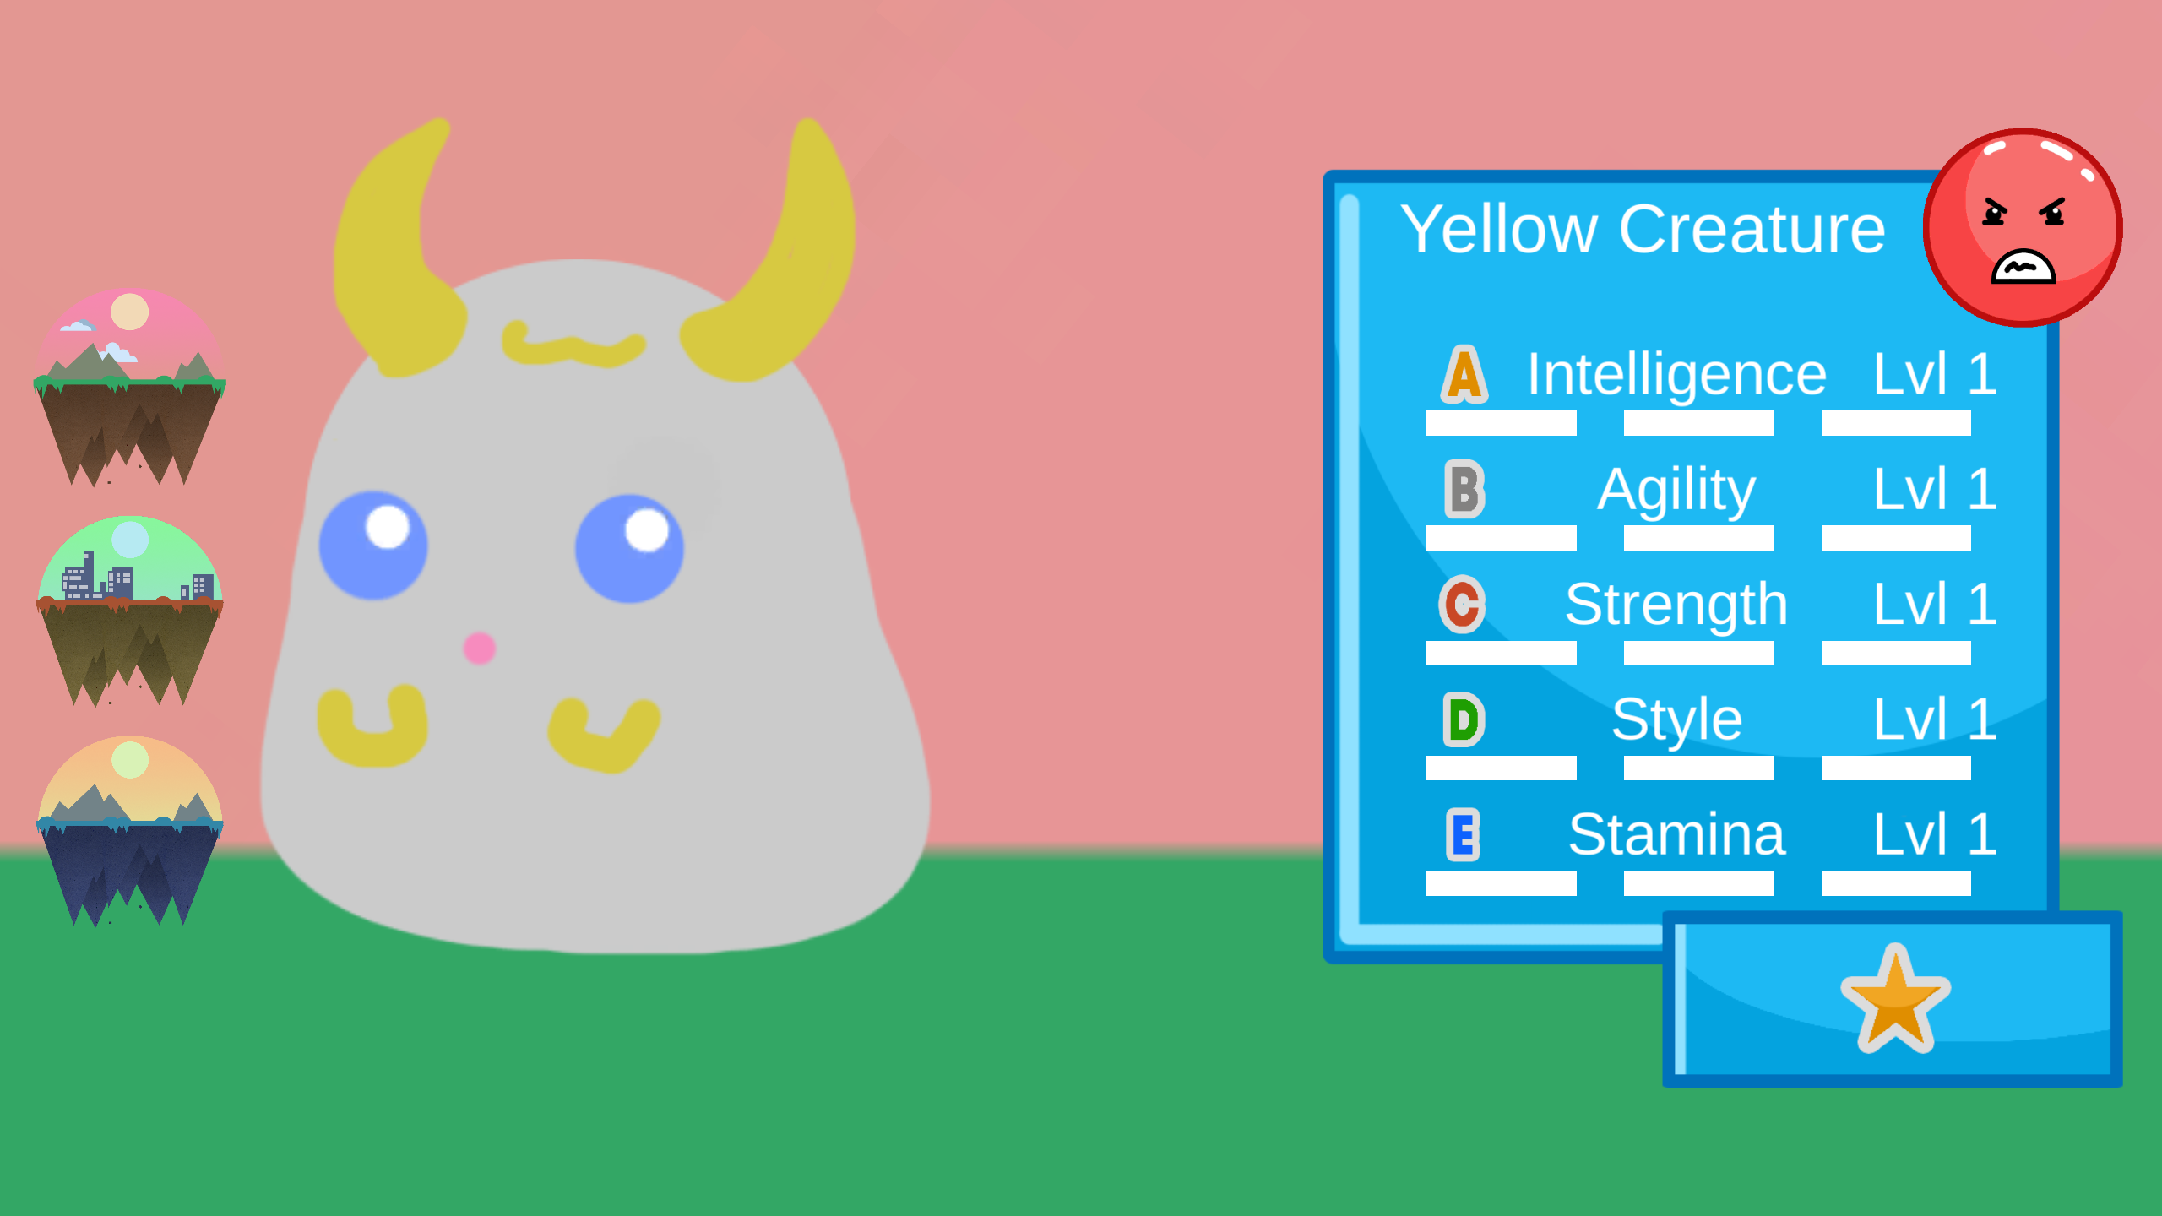
Representing mood in Gaia

Slide 19
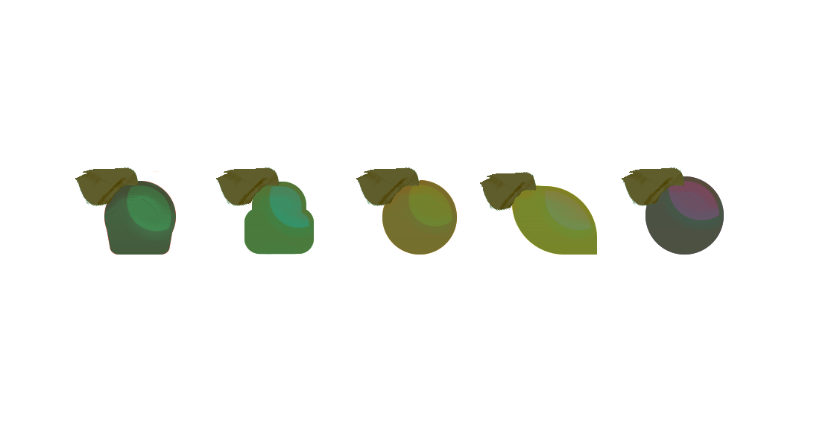
Loss Aversion
Is used to encourage players to remain engaged with their pets and the game space
Fruit will rot on trees
Pet mood decreases over time

Slide 20
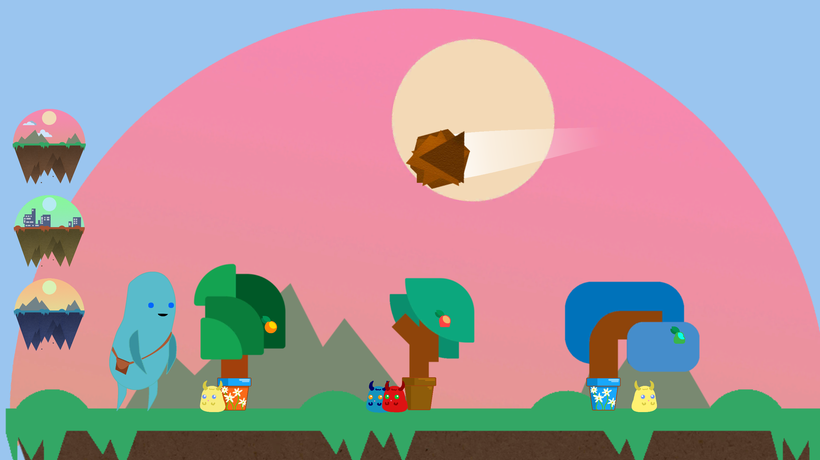
Variable Reward Schedule
1 in 5 chance of receiving a gift from a pet upon levelling up
Random chance of Meteor Event occurring between 4-8 mins
1 in 10 chance of a STAT Affinity increasing when pets are bred

Slide 21
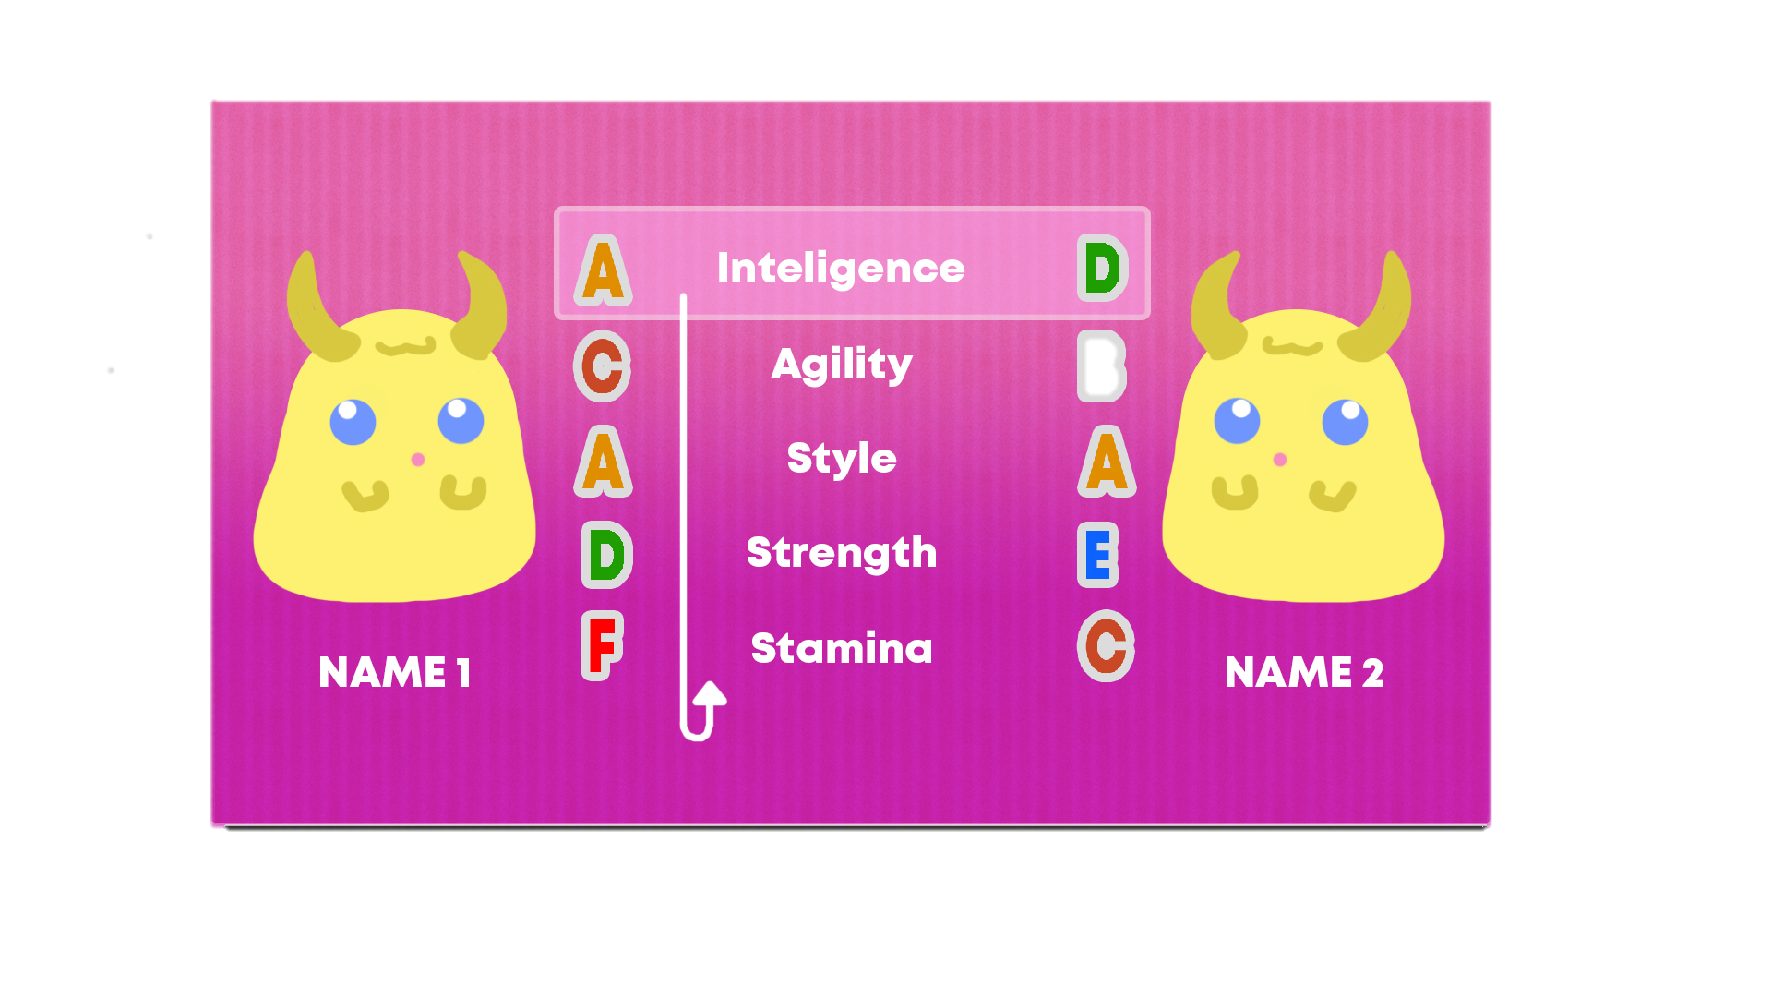
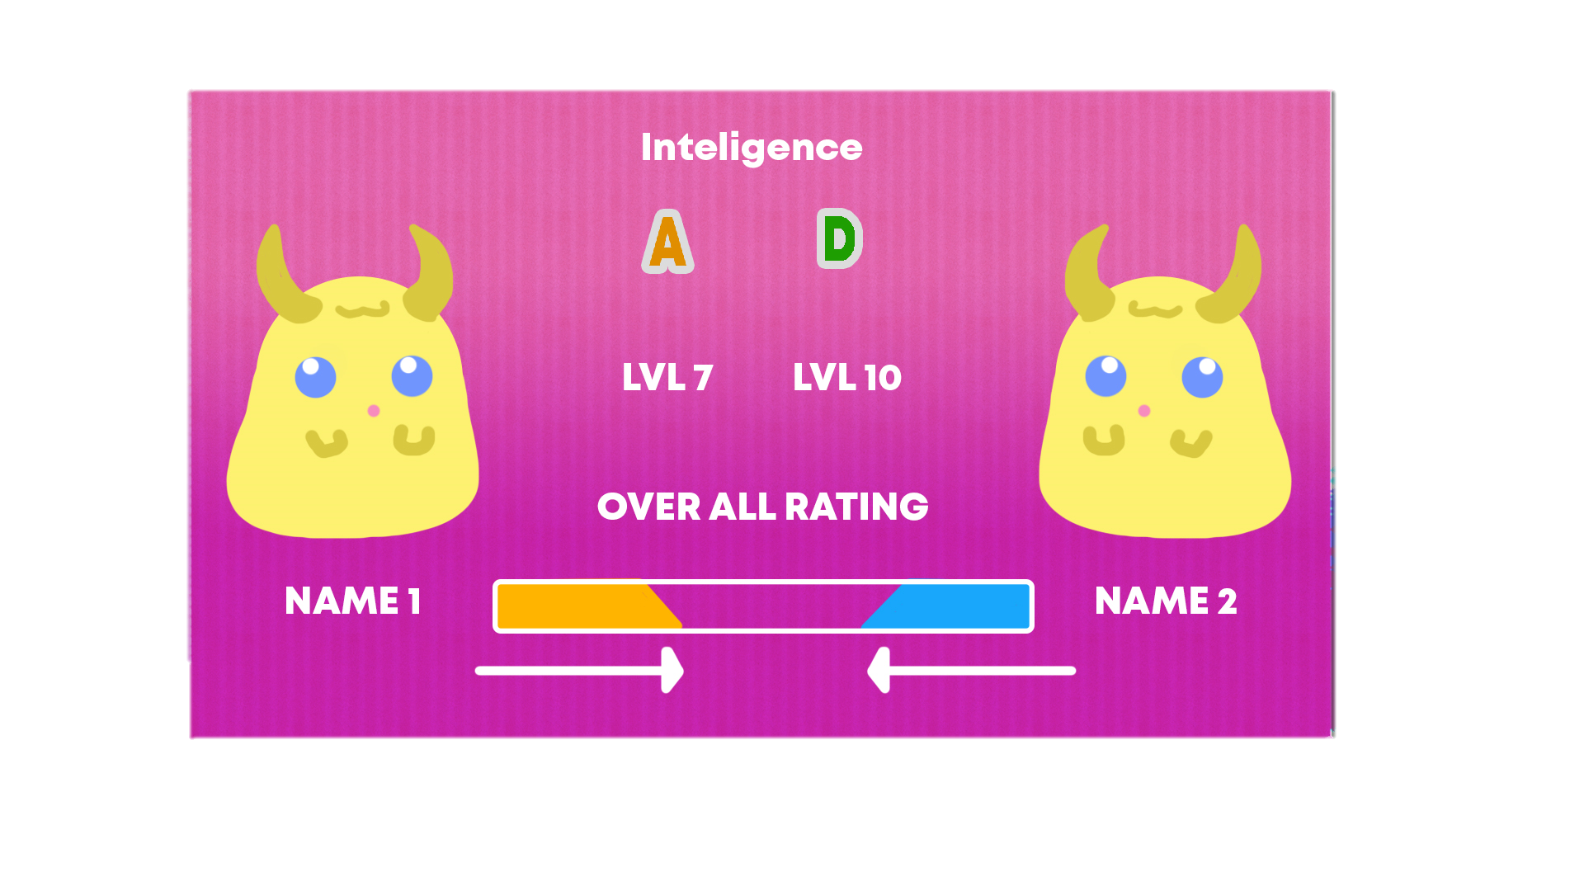
Contest

Slide 22
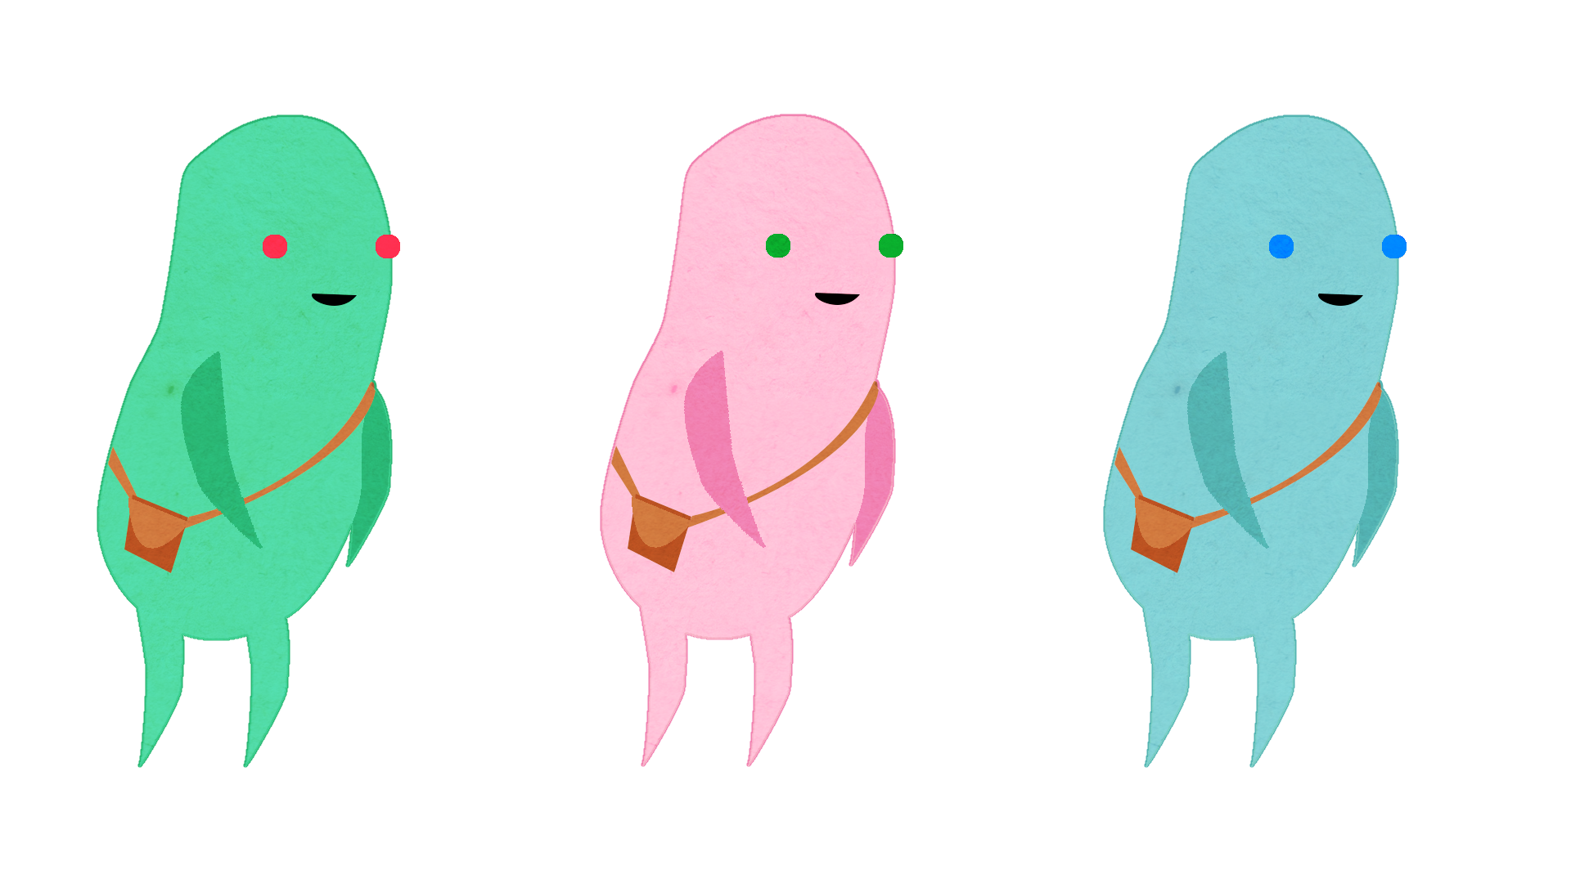
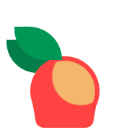
Thank You
Any Questions?

